Slide 1
Stock Price
Analysis and Forecasting
Shuntao Chen
Yiling Kang

Slide 2
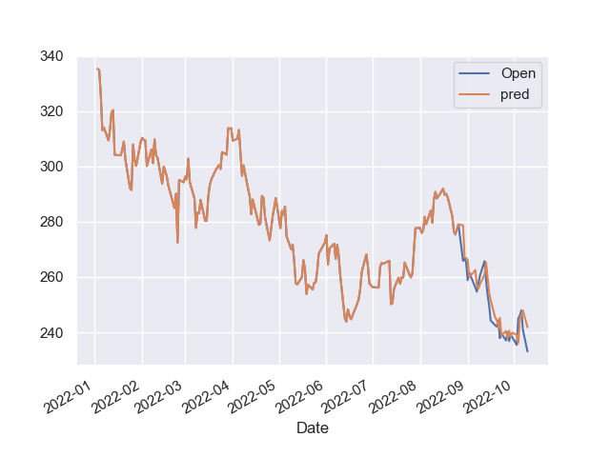
Background
Then investor would like to know during the past, how the stock price changed, what is the largest inflation and ideally how the price will go in the future.
Also for multiple stocks, investor would be interested in which stock performs the best in the past, and which one should I invest in order to maximize the profit.

Slide 3
Use Case
For example, the user may wants to know how the TESLA changed from 2020 to present, and how it behaves comparing with other stocks.
The user may also interesting in how the price will change tomorrow, this is important for him/her to decide whether to buy the stock.
For multiple stocks, which one can maximize the profit.
We can not know in advance which stock and time the user want, and it is unrealistic to store all the datas locally.
We will need an API to read data based on the users request.

Slide 4
Python Libraries
pandas
numpy
matplotlib
seaborn
datetime: package that deal with the time
pandas_datareader: package for reading data
plotly: package for visualization

Slide 5
pandas_datareader
We allow user to specify the stock symbol and time range.
We can read data based on user request.
pandas_datareader package can read stock data from different sources, here we choose “Yahoo Finance”
In this way, we do not need to store the data locally.
We can build a tool for user to make analysis and do prediction.

Slide 6
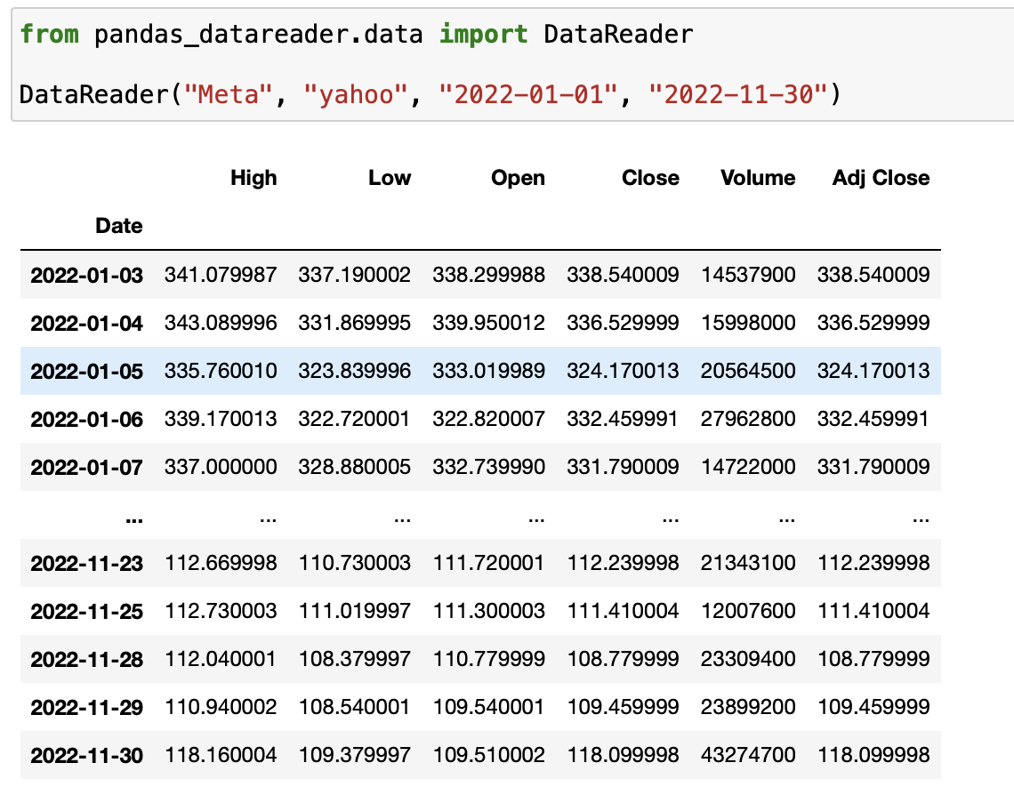
Caption

Slide 7
plotly
Advanced package which can easily produce professional financial plots
We can add some interactive icons to the plot
We can zoom in and zoom out the plot to see specific part
We can see the detail of data by putting mouse on that point
We can hide and unhide some lines by click the label of legend

Slide 8
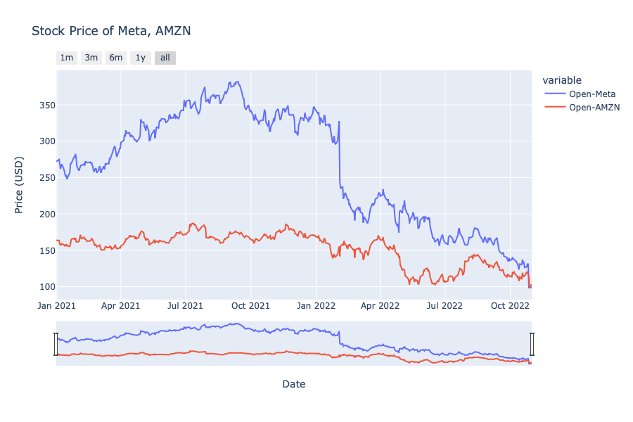

Slide 9
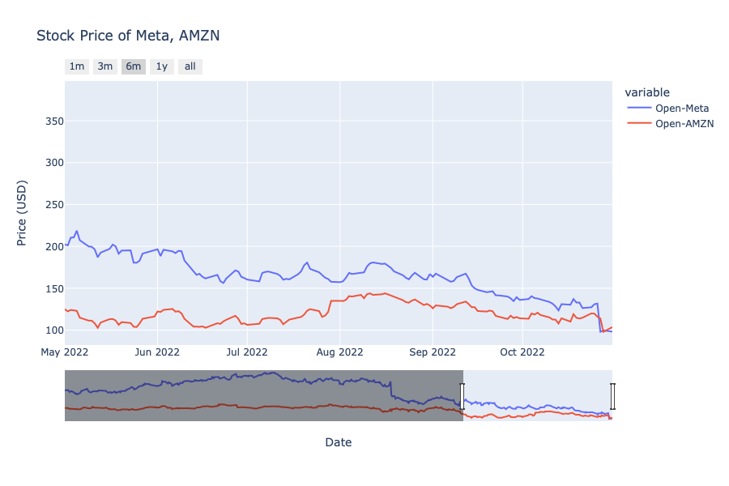
Caption

Slide 10
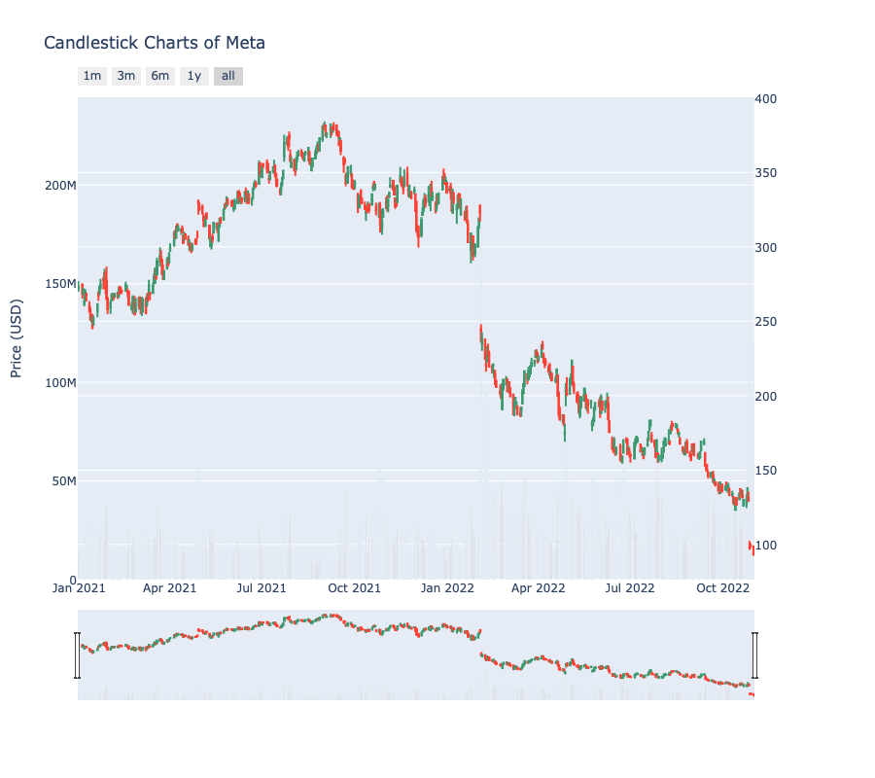
Caption

Slide 11
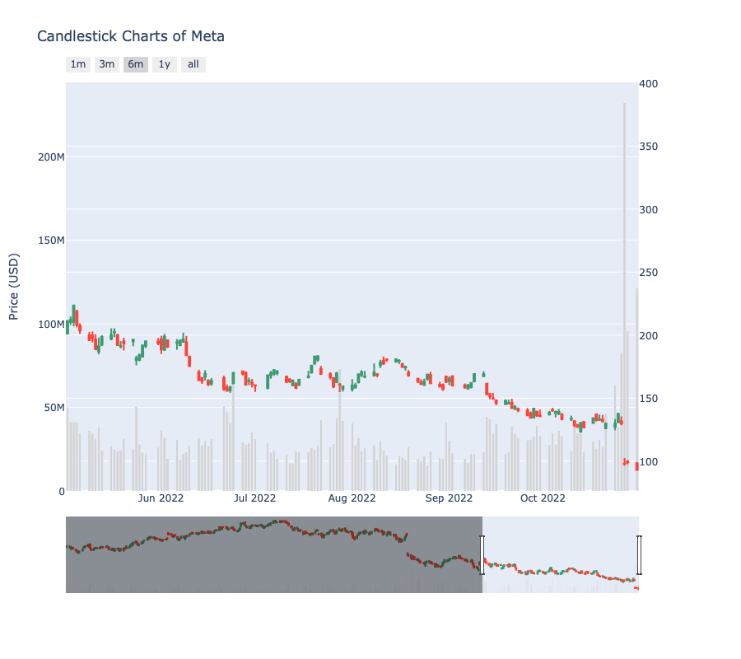
Caption

Slide 12
ML Model
TBATS: a model combined the box-cox, trend, multi-seasonality and ARIMA residual. Performed not bad for the first few steps.
Geometric Brownian Motion: (On going)
What we can get from the model: tomorrow’s price and confidence interval.
How user can use this: buy the stock if the predicted value is an increase.
How to determine the model accuracy: use this strategy for 30 days and see how much profit we can gain.

